Slide 1
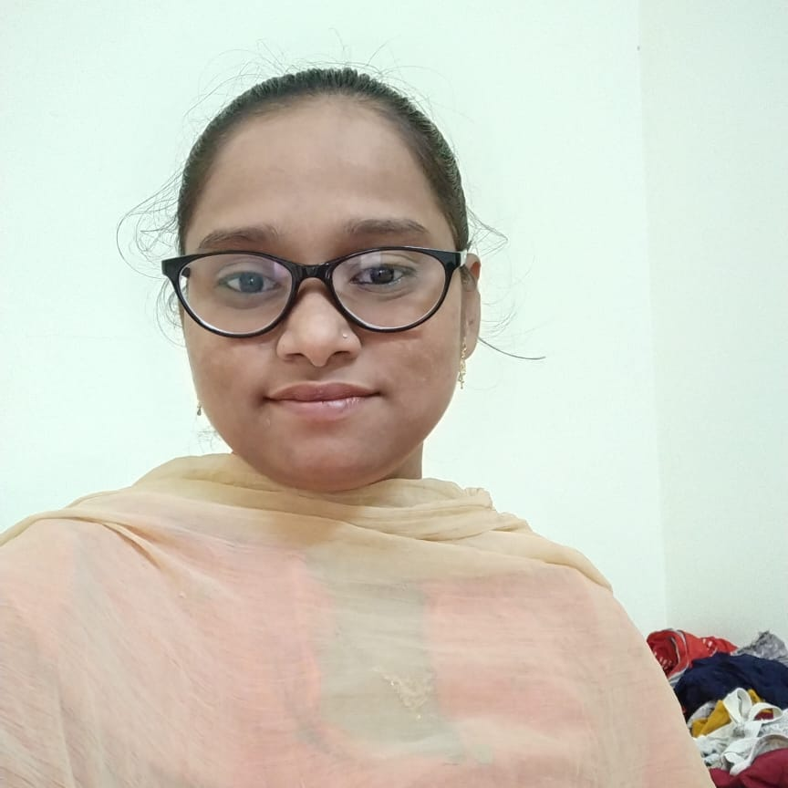



Shaik sheerin
Bachelor of Technology
Computer Science : 2015 - 2019
Analyst/Software Engineer
Skills
Java 8 /J2EE | Java Basics, OOPS, Generics, Collections, Arrays, Loops, Lambda Exp, Stream API Junit, Mockito, Servlets
Spring core | IOC & Dependency Injection, Autowire
Spring REST | REST controllers, Implementation of GET, POST, PUT & DELETE, Bean Validation & Exception Handling, Testing Services, Controller & Repository layer
Spring Data JPA | Implement DAO layer using spring Data repositories, Transaction Management
Spring Boot Microservices | Spring Boot Starters, annotations, Messaging Service, Sync/Async comms, Swagger API documents
Spring Cloud | Eureka, Netflix Ribbon, Feign Client, Netflix Hystrix, Netflix Zuul & Config Server
ReactJs | Components, Hooks, Event handling, Redux, Reducers, Testing using Jasmin & Karma
Database | MongoDB, No Sql Basics, My SQL RDS Basics
UI Tech | HTML 5 & CSS 3,JavaScript, ES6 & TypeScript Reusable templates, Optimized UI Designed
Tools | Git, Postman, Maven, IDE
Devops | CI/CD, Jenkins configuration, Build Pipelines, notifications, quality gate understanding
Add On skills | Communications, Team management. Peer learning
Bangalore
SHEERIN.SHAIK@CAPGEMINI.COM
+91 9030668586
A4
MERN (Mongo, React, Express and Node) developer
Hands on experience in developing web pages using HTML5, CSS3, Object Oriented Java script, ES6&JSON, XML. Good understanding of Document Object Model (DOM) and DOM Functions.
Practical understanding of advanced Java script concepts, such as Prototype, Closure, Scope Chain and Promise.
Proficient React developer with working knowledge on ReactJS(redux).
Java Microservice Development knowledge using Spring boot and spring cloud framework on an intermediate level.
Implemented Nodejs and ExpressJs in case study and upskilling his knowledge continuously.
Experienced in practicing TDD based development using tools like Mockito, Junit and ensuring quality
Online hotel management system Application
Completed end to end case study of Online hotel management system Application along with JWT authentication, Swagger and payment testing using Braintree in MERN Stack. Material-UI and React Bootstrap used for user interface.
Online Hotel booking Application
Developed Online Hotel booking Application Using spring microservices and Reactjs with MongoDB as database in agile methodology of software development model.
HTML CSS JAVASCRIPT for web developers at Coursera
Completed this course with 98.6% and Designed responsive Hotel website using HTML5 CSS3 Bootstrap and Java script.
Completed ”Build your first React website“ course at Coursera
Check out my work on GitHub & Video Profile

